Slide 1
18-447 Computer Architecture Lecture 24: Simulation and Memory Latency Tolerance
Prof. Onur Mutlu
Carnegie Mellon University
Spring 2015, 3/30/2015

Slide 2
Lab 5 Results
Avg: 84.4
Median: 93.8
Std Dev: 19.2

Slide 3
Reminder on Assignments
Lab 6 due this Friday (April 3)
C-level simulation of data caches and branch prediction
Homework 6 will be due April 10
And, we will have a Midterm II
The course will continue to move quickly… Keep your pace.
Talk with the TAs and me if you need any help.
We cannot do or debug the assignments for you but we can give you suggestions
My goal is to enable you learn the material
You never know when you will use the principles you learn

Slide 4
Simulation: The Field of Dreams

Slide 5
Dreaming and Reality
An architect is in part a dreamer, a creator
Simulation is a key tool of the architect
Simulation enables
The exploration of many dreams
A reality check of the dreams
Deciding which dream is better
Simulation also enables
The ability to fool yourself with false dreams

Slide 6
Why High-Level Simulation?
Problem: RTL simulation is intractable for design space exploration → too time consuming to design and evaluate
Especially over a large number of workloads
Especially if you want to predict the performance of a good chunk of a workload on a particular design
Especially if you want to consider many design choices
Cache size, associativity, block size, algorithms
Memory control and scheduling algorithms
In-order vs. out-of-order execution
Reservation station sizes, ld/st queue size, register file size, …
…
Goal: Explore design choices quickly to see their impact on the workloads we are designing the platform for

Slide 7
Different Goals in Simulation
Explore the design space quickly and see what you want to
potentially implement in a next-generation platform
propose as the next big idea to advance the state of the art
the goal is mainly to see relative effects of design decisions
Match the behavior of an existing system so that you can
debug and verify it at cycle-level accuracy
propose small tweaks to the design that can make a difference in performance or energy
the goal is very high accuracy
Other goals in-between:
Refine the explored design space without going into a full detailed, cycle-accurate design
Gain confidence in your design decisions made by higher-level design space exploration

Slide 8
Tradeoffs in Simulation
Three metrics to evaluate a simulator
Speed
Flexibility
Accuracy
Speed: How fast the simulator runs (xIPS, xCPS)
Flexibility: How quickly one can modify the simulator to evaluate different algorithms and design choices?
Accuracy: How accurate the performance (energy) numbers the simulator generates are vs. a real design (Simulation error)
The relative importance of these metrics varies depending on where you are in the design process

Slide 9
Trading Off Speed, Flexibility, Accuracy
Speed & flexibility affect:
How quickly you can make design tradeoffs
Accuracy affects:
How good your design tradeoffs may end up being
How fast you can build your simulator (simulator design time)
Flexibility also affects:
How much human effort you need to spend modifying the simulator
You can trade off between the three to achieve design exploration and decision goals

Slide 10
High-Level Simulation
Key Idea: Raise the abstraction level of modeling to give up some accuracy to enable speed & flexibility (and quick simulator design)
Advantage
+ Can still make the right tradeoffs, and can do it quickly
+ All you need is modeling the key high-level factors, you can omit corner case conditions
+ All you need is to get the “relative trends” accurately, not exact performance numbers
Disadvantage
-- Opens up the possibility of potentially wrong decisions
-- How do you ensure you get the “relative trends” accurately?

Slide 11
Simulation as Progressive Refinement
High-level models (Abstract, C)
…
Medium-level models (Less abstract)
…
Low-level models (RTL with eveything modeled)
…
Real design
As you refine (go down the above list)
Abstraction level reduces
Accuracy (hopefully) increases (not necessarily, if not careful)
Speed and flexibility reduce
You can loop back and fix higher-level models

Slide 12
This Course
A good architect is comfortable at all levels of refinement
Including the extremes
This course, as a result, gives you a flavor of both:
High-level, abstract simulation (Labs 6, 7, 8)
Low-level, RTL simulation (Labs 2, 3, 4, 5)

Slide 13
Optional Reading on DRAM Simulation
Kim et al., “Ramulator: A Fast and Extensible DRAM Simulator,” IEEE Computer Architecture Letters 2015.
https://github.com/CMU-SAFARI/ramulator
http://users.ece.cmu.edu/~omutlu/pub/ramulator_dram_simulator-ieee-cal15.pdf

Slide 14
Where We Are in Lecture Schedule
The memory hierarchy
Caches, caches, more caches
Virtualizing the memory hierarchy: Virtual Memory
Main memory: DRAM
Main memory control, scheduling
Memory latency tolerance techniques
Non-volatile memory
Multiprocessors
Coherence and consistency
Interconnection networks
Multi-core issues (e.g., heterogeneous multi-core)

Slide 15
Upcoming Seminar on DRAM (April 3)
April 3, Friday, 11am-noon, GHC 8201
Prof. Moinuddin Qureshi, Georgia Tech
Lead author of “MLP-Aware Cache Replacement”
Architecting 3D Memory Systems
Die stacked 3D DRAM technology can provide low-energy high-bandwidth memory module by vertically integrating several dies within the same chip. (…) In this talk, I will discuss how memory systems can efficiently architect 3D DRAM either as a cache or as main memory. First, I will show that some of the basic design decisions typically made for conventional caches (such as serialization of tag and data access, large associativity, and update of replacement state) are detrimental to the performance of DRAM caches, as they exacerbate hit latency. (…) Finally, I will present a memory organization that allows 3D DRAM to be a part of the OS-visible memory address space, and yet relieves the OS from data migration duties. (…)”

Slide 16
Required Reading
Onur Mutlu, Justin Meza, and Lavanya Subramanian, "The Main Memory System: Challenges and Opportunities" Invited Article in Communications of the Korean Institute of Information Scientists and Engineers (KIISE), 2015.
http://users.ece.cmu.edu/~omutlu/pub/main-memory-system_kiise15.pdf

Slide 17
Required Readings on DRAM
DRAM Organization and Operation Basics
Sections 1 and 2 of: Lee et al., “Tiered-Latency DRAM: A Low Latency and Low Cost DRAM Architecture,” HPCA 2013.
http://users.ece.cmu.edu/~omutlu/pub/tldram_hpca13.pdf
Sections 1 and 2 of Kim et al., “A Case for Subarray-Level Parallelism (SALP) in DRAM,” ISCA 2012.
http://users.ece.cmu.edu/~omutlu/pub/salp-dram_isca12.pdf
DRAM Refresh Basics
Sections 1 and 2 of Liu et al., “RAIDR: Retention-Aware Intelligent DRAM Refresh,” ISCA 2012. http://users.ece.cmu.edu/~omutlu/pub/raidr-dram-refresh_isca12.pdf

Slide 18
Readings on Bloom Filters
Section 3.1 of
Seshadri et al., “The Evicted-Address Filter: A Unified Mechanism to Address Both Cache Pollution and Thrashing,” PACT 2012.
Section 3.3 of
Liu et al., “RAIDR: Retention-Aware Intelligent DRAM Refresh,” ISCA 2012.

Slide 19
Difficulty of DRAM Control

Slide 20
Why are DRAM Controllers Difficult to Design?
Need to obey DRAM timing constraints for correctness
There are many (50+) timing constraints in DRAM
tWTR: Minimum number of cycles to wait before issuing a read command after a write command is issued
tRC: Minimum number of cycles between the issuing of two consecutive activate commands to the same bank
…
Need to keep track of many resources to prevent conflicts
Channels, banks, ranks, data bus, address bus, row buffers
Need to handle DRAM refresh
Need to manage power consumption
Need to optimize performance & QoS (in the presence of constraints)
Reordering is not simple
Fairness and QoS needs complicates the scheduling problem

Slide 21
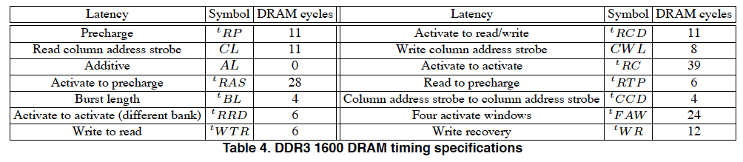
Many DRAM Timing Constraints
From Lee et al., “DRAM-Aware Last-Level Cache Writeback: Reducing Write-Caused Interference in Memory Systems,” HPS Technical Report, April 2010.

Slide 22
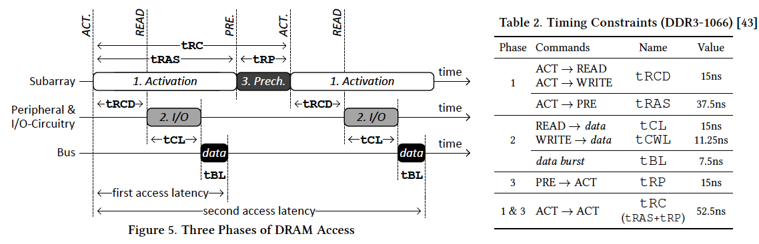
More on DRAM Operation
Kim et al., “A Case for Exploiting Subarray-Level Parallelism (SALP) in DRAM,” ISCA 2012.
Lee et al., “Tiered-Latency DRAM: A Low Latency and Low Cost DRAM Architecture,” HPCA 2013.

Slide 23
DRAM Controller Design Is Becoming More Difficult
CPU
CPU
CPU
CPU
GPU
HWA
HWA
Shared Cache
DRAM and Hybrid Memory Controllers
DRAM and Hybrid Memories
Heterogeneous agents: CPUs, GPUs, and HWAs
Main memory interference between CPUs, GPUs, HWAs
Many timing constraints for various memory types
Many goals at the same time: performance, fairness, QoS, energy efficiency, …

Slide 24
Reality and Dream
Reality: It difficult to optimize all these different constraints while maximizing performance, QoS, energy-efficiency, …
Dream: Wouldn’t it be nice if the DRAM controller automatically found a good scheduling policy on its own?

Slide 25
Self-Optimizing DRAM Controllers
Problem: DRAM controllers difficult to design → It is difficult for human designers to design a policy that can adapt itself very well to different workloads and different system conditions
Idea: Design a memory controller that adapts its scheduling policy decisions to workload behavior and system conditions using machine learning.
Observation: Reinforcement learning maps nicely to memory control.
Design: Memory controller is a reinforcement learning agent that dynamically and continuously learns and employs the best scheduling policy.
Ipek+, “Self Optimizing Memory Controllers: A Reinforcement Learning Approach,” ISCA 2008.

Slide 26
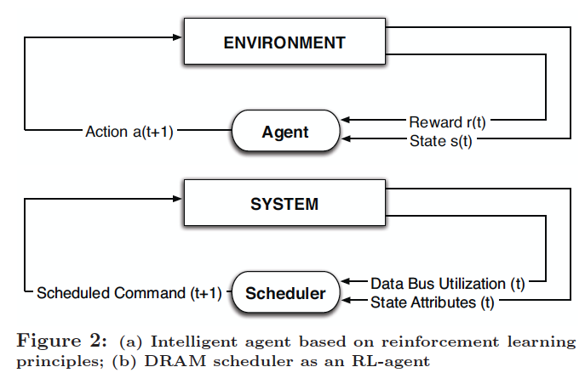
Self-Optimizing DRAM Controllers
Engin Ipek, Onur Mutlu, José F. Martínez, and Rich Caruana, "Self Optimizing Memory Controllers: A Reinforcement Learning Approach" Proceedings of the 35th International Symposium on Computer Architecture (ISCA), pages 39-50, Beijing, China, June 2008.
Goal: Learn to choose actions to maximize r₀ + γr₁ + γ²r₂ + … ( 0 ≤ γ < 1)

Slide 27
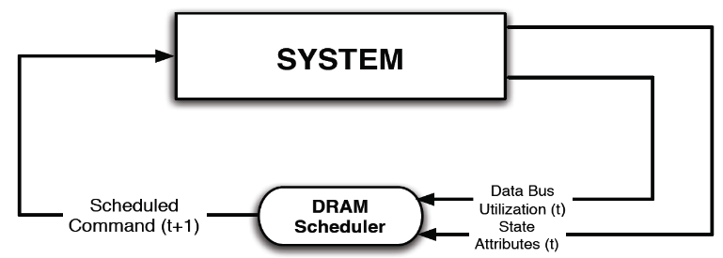
Self-Optimizing DRAM Controllers
Dynamically adapt the memory scheduling policy via interaction with the system at runtime
Associate system states and actions (commands) with long term reward values: each action at a given state leads to a learned reward
Schedule command with highest estimated long-term reward value in each state
Continuously update reward values for <state, action> pairs based on feedback from system

Slide 28
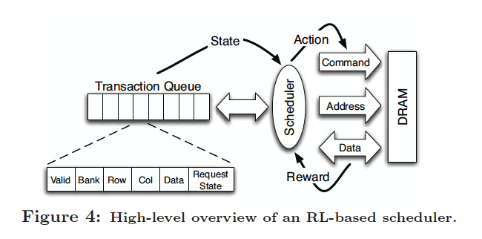
Self-Optimizing DRAM Controllers
Engin Ipek, Onur Mutlu, José F. Martínez, and Rich Caruana, "Self Optimizing Memory Controllers: A Reinforcement Learning Approach" Proceedings of the 35th International Symposium on Computer Architecture (ISCA), pages 39-50, Beijing, China, June 2008.

Slide 29
States, Actions, Rewards
Reward function
+1 for scheduling Read and Write commands
0 at all other times
Goal is to maximize data bus utilization
State attributes
Number of reads, writes, and load misses in transaction queue
Number of pending writes and ROB heads waiting for referenced row
Request’s relative ROB order
Actions
Activate
Write
Read - load miss
Read - store miss
Precharge - pending
Precharge - preemptive
NOP

Slide 30
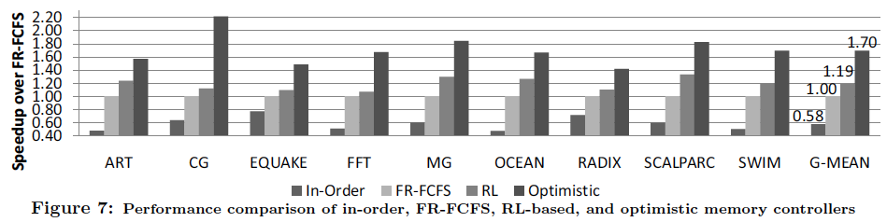
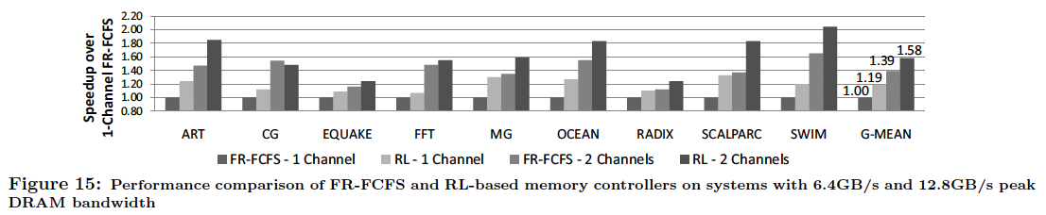
Performance Results

Slide 31
Self Optimizing DRAM Controllers
Advantages
+ Adapts the scheduling policy dynamically to changing workload behavior and to maximize a long-term target
+ Reduces the designer’s burden in finding a good scheduling policy. Designer specifies:
1) What system variables might be useful
2) What target to optimize, but not how to optimize it
Disadvantages and Limitations
-- Black box: designer much less likely to implement what she cannot easily reason about
-- How to specify different reward functions that can achieve different objectives? (e.g., fairness, QoS)
-- Hardware complexity?

Slide 32
Memory Latency Tolerance

Slide 33
Readings on Memory Latency Tolerance
Required
Mutlu et al., “Runahead Execution: An Alternative to Very Large Instruction Windows for Out-of-order Processors,” HPCA 2003.
Srinath et al., “Feedback directed prefetching”, HPCA 2007.
Optional
Mutlu et al., “Efficient Runahead Execution: Power-Efficient Memory Latency Tolerance,” ISCA 2005, IEEE Micro Top Picks 2006.
Mutlu et al., “Address-Value Delta (AVD) Prediction,” MICRO 2005.
Armstrong et al., “Wrong Path Events,” MICRO 2004.

Slide 34
Remember: Latency Tolerance
An out-of-order execution processor tolerates latency of multi-cycle operations by executing independent instructions concurrently
It does so by buffering instructions in reservation stations and reorder buffer
Instruction window: Hardware resources needed to buffer all decoded but not yet retired/committed instructions
What if an instruction takes 500 cycles?
How large of an instruction window do we need to continue decoding?
How many cycles of latency can OoO tolerate?

Slide 35
Stalls due to Long-Latency Instructions
When a long-latency instruction is not complete, it blocks instruction retirement.
Because we need to maintain precise exceptions
Incoming instructions fill the instruction window (reorder buffer, reservation stations).
Once the window is full, processor cannot place new instructions into the window.
This is called a full-window stall.
A full-window stall prevents the processor from making progress in the execution of the program.

Slide 36
Full-window Stall Example
8-entry instruction window:
Oldest
LOAD R1 ← mem[R5]
L2 Miss! Takes 100s of cycles.
BEQ R1, R0, target
ADD R2 ← R2, 8
LOAD R3 ← mem[R2]
Independent of the L2 miss,
executed out of program order,
but cannot be retired.
MUL R4 ← R4, R3
ADD R4 ← R4, R5
STOR mem[R2] ← R4
ADD R2 ← R2, 64
Younger instructions cannot be executed
because there is no space in the instruction window.
LOAD R3 ← mem[R2]
The processor stalls until the L2 Miss is serviced.
Long-latency cache misses are responsible for
most full-window stalls.

Slide 37
Cache Misses Responsible for Many Stalls
L2 Misses
512KB L2 cache, 500-cycle DRAM latency, aggressive stream-based prefetcher
Data averaged over 147 memory-intensive benchmarks on a high-end x86 processor model

Slide 38
The Memory Latency Problem
Problem: Memory latency is long
And, it is not easy to reduce it…
We will look at methods for reducing DRAM latency in a later lecture
Lee et al. “Tiered-Latency DRAM,” HPCA 2013.
Lee et al., “Adaptive-Latency DRAM,” HPCA 2014.
And, even if we reduce memory latency, it is still long
Remember the fundamental capacity-latency tradeoff
Contention for memory increases latencies

Slide 39
How Do We Tolerate Stalls Due to Memory?
Two major approaches
Reduce/eliminate stalls
Tolerate the effect of a stall when it happens
Four fundamental techniques to achieve these
Caching
Prefetching
Multithreading
Out-of-order execution
Many techniques have been developed to make these four fundamental techniques more effective in tolerating memory latency

Slide 40
Memory Latency Tolerance Techniques
Caching [initially by Wilkes, 1965]
Widely used, simple, effective, but inefficient, passive
Not all applications/phases exhibit temporal or spatial locality
Prefetching [initially in IBM 360/91, 1967]
Works well for regular memory access patterns
Prefetching irregular access patterns is difficult, inaccurate, and hardware-intensive
Multithreading [initially in CDC 6600, 1964]
Works well if there are multiple threads
Improving single thread performance using multithreading hardware is an ongoing research effort
Out-of-order execution [initially by Tomasulo, 1967]
Tolerates irregular cache misses that cannot be prefetched
Requires extensive hardware resources for tolerating long latencies
Runahead execution alleviates this problem (as we will see today)

Slide 41
Runahead Execution

Slide 42
Small Windows: Full-window Stalls
8-entry instruction window:
Oldest
LOAD R1 ← mem[R5]
L2 Miss! Takes 100s of cycles.
BEQ R1, R0, target
ADD R2 ← R2, 8
LOAD R3 ← mem[R2]
Independent of the L2 miss,
executed out of program order,
but cannot be retired.
MUL R4 ← R4, R3
ADD R4 ← R4, R5
STOR mem[R2] ← R4
ADD R2 ← R2, 64
Younger instructions cannot be executed
because there is no space in the instruction window.
LOAD R3 ← mem[R2]
The processor stalls until the L2 Miss is serviced.
Long-latency cache misses are responsible for most full-window stalls.

Slide 43
Impact of Long-Latency Cache Misses
L2 Misses
512KB L2 cache, 500-cycle DRAM latency, aggressive stream-based prefetcher
Data averaged over 147 memory-intensive benchmarks on a high-end x86 processor model

Slide 44
Impact of Long-Latency Cache Misses
L2 Misses
500-cycle DRAM latency, aggressive stream-based prefetcher
Data averaged over 147 memory-intensive benchmarks on a high-end x86 processor model

Slide 45
The Problem
Out-of-order execution requires large instruction windows to tolerate today’s main memory latencies.
As main memory latency increases, instruction window size should also increase to fully tolerate the memory latency.
Building a large instruction window is a challenging task if we would like to achieve
Low power/energy consumption (tag matching logic, ld/st buffers)
Short cycle time (access, wakeup/select latencies)
Low design and verification complexity

Slide 46
Efficient Scaling of Instruction Window Size
One of the major research issues in out of order execution
How to achieve the benefits of a large window with a small one (or in a simpler way)?
How do we efficiently tolerate memory latency with the machinery of out-of-order execution (and a small instruction window)?

Slide 47
Memory Level Parallelism (MLP)
Idea: Find and service multiple cache misses in parallel so that the processor stalls only once for all misses
Enables latency tolerance: overlaps latency of different misses
How to generate multiple misses?
Out-of-order execution, multithreading, prefetching, runahead
isolated miss
parallel miss
B
A
C
time

Slide 48
Runahead Execution (I)
A technique to obtain the memory-level parallelism benefits of a large instruction window
When the oldest instruction is a long-latency cache miss:
Checkpoint architectural state and enter runahead mode
In runahead mode:
Speculatively pre-execute instructions
The purpose of pre-execution is to generate prefetches
L2-miss dependent instructions are marked INV and dropped
Runahead mode ends when the original miss returns
Checkpoint is restored and normal execution resumes
Mutlu et al., “Runahead Execution: An Alternative to Very Large Instruction Windows for Out-of-order Processors,” HPCA 2003.

Slide 49
Runahead Example
Perfect Caches:
Load 1 Hit
Load 2 Hit
Compute
Compute
Small Window:
Load 1 Miss
Load 2 Miss
Compute
Stall
Compute
Stall
Miss 1
Miss 2
Runahead:
Load 1 Miss
Load 2 Miss
Load 1 Hit
Load 2 Hit
Compute
Runahead
Compute
Saved Cycles
Miss 1
Miss 2

Slide 50
Benefits of Runahead Execution
Instead of stalling during an L2 cache miss:
Pre-executed loads and stores independent of L2-miss instructions generate very accurate data prefetches:
For both regular and irregular access patterns
Instructions on the predicted program path are prefetched into the instruction/trace cache and L2.
Hardware prefetcher and branch predictor tables are trained using future access information.

Slide 51
Runahead Execution Mechanism
Entry into runahead mode
Checkpoint architectural register state
Instruction processing in runahead mode
Exit from runahead mode
Restore architectural register state from checkpoint

Slide 52
Instruction Processing in Runahead Mode
Load 1 Miss
Compute
Runahead
Miss 1
Runahead mode processing is the same as normal instruction processing, EXCEPT:
It is purely speculative: Architectural (software-visible) register/memory state is NOT updated in runahead mode.
L2-miss dependent instructions are identified and treated specially.
They are quickly removed from the instruction window.
Their results are not trusted.

Slide 53
L2-Miss Dependent Instructions
Load 1 Miss
Compute
Runahead
Miss 1
Two types of results produced: INV and VALID
INV = Dependent on an L2 miss
INV results are marked using INV bits in the register file and store buffer.
INV values are not used for prefetching/branch resolution.

Slide 54
Removal of Instructions from Window
Load 1 Miss
Compute
Runahead
Miss 1
Oldest instruction is examined for pseudo-retirement
An INV instruction is removed from window immediately.
A VALID instruction is removed when it completes execution.
Pseudo-retired instructions free their allocated resources.
This allows the processing of later instructions.
Pseudo-retired stores communicate their data to dependent loads.
Notes:
Exceptions ignored. I/O operations that modify the state of the I/O devices are not performed. Uncacheable blocks are not fetched.

Slide 55
Store/Load Handling in Runahead Mode
Load 1 Miss
Compute
Runahead
Miss 1
A pseudo-retired store writes its data and INV status to a dedicated memory, called runahead cache.
Purpose: Data communication through memory in runahead mode.
A dependent load reads its data from the runahead cache.
Does not need to be always correct → Size of runahead cache is very small.

Slide 56
Branch Handling in Runahead Mode
Load 1 Miss
Compute
Runahead
Miss 1
INV branches cannot be resolved.
A mispredicted INV branch causes the processor to stay on the wrong program path until the end of runahead execution.
VALID branches are resolved and initiate recovery if mispredicted.

Slide 57
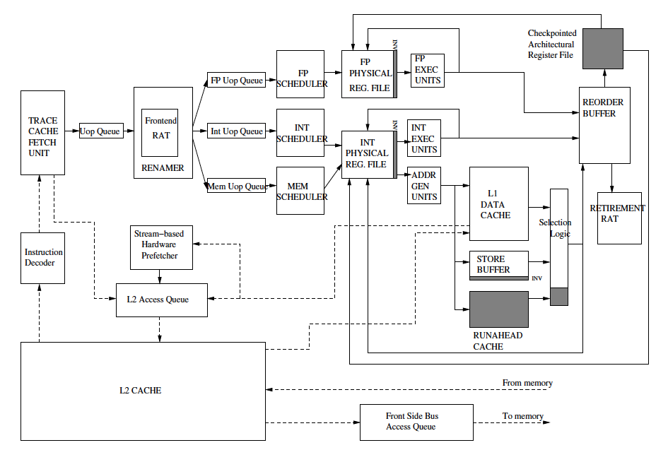
A Runahead Processor Diagram
Mutlu+, “Runahead Execution,”
HPCA 2003.

Slide 58
Runahead Execution Pros and Cons
Advantages:
+ Very accurate prefetches for data/instructions (all cache levels)
+ Follows the program path
+ Simple to implement, most of the hardware is already built in
+ Versus other pre-execution based prefetching mechanisms (as we will see):
+ Uses the same thread context as main thread, no waste of context
+ No need to construct a pre-execution thread
Disadvantages/Limitations:
-- Extra executed instructions
-- Limited by branch prediction accuracy
-- Cannot prefetch dependent cache misses
-- Effectiveness limited by available “memory-level parallelism” (MLP)
-- Prefetch distance limited by memory latency
Implemented in IBM POWER6, Sun “Rock”

Slide 59
Performance of Runahead Execution

Slide 60
Runahead Execution vs. Large Windows

Slide 61
Runahead vs. A (Real) Large Window
When is one beneficial, when is the other?
Pros and cons of each
Which can tolerate FP operation latencies better?
Which leads to less wasted execution?

Slide 62
Runahead on In-order vs. Out-of-order

Slide 63
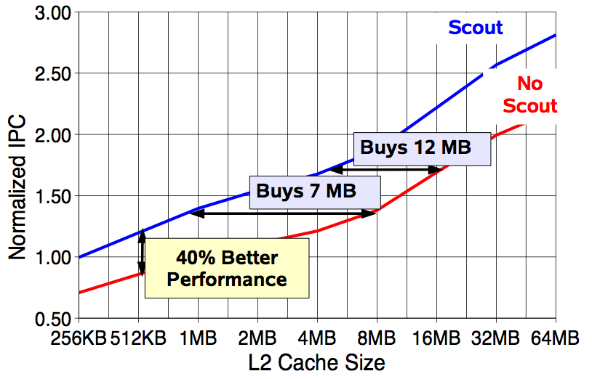
Effect of Runahead in Sun ROCK
Shailender Chaudhry talk, Aug 2008.

